Slide 1
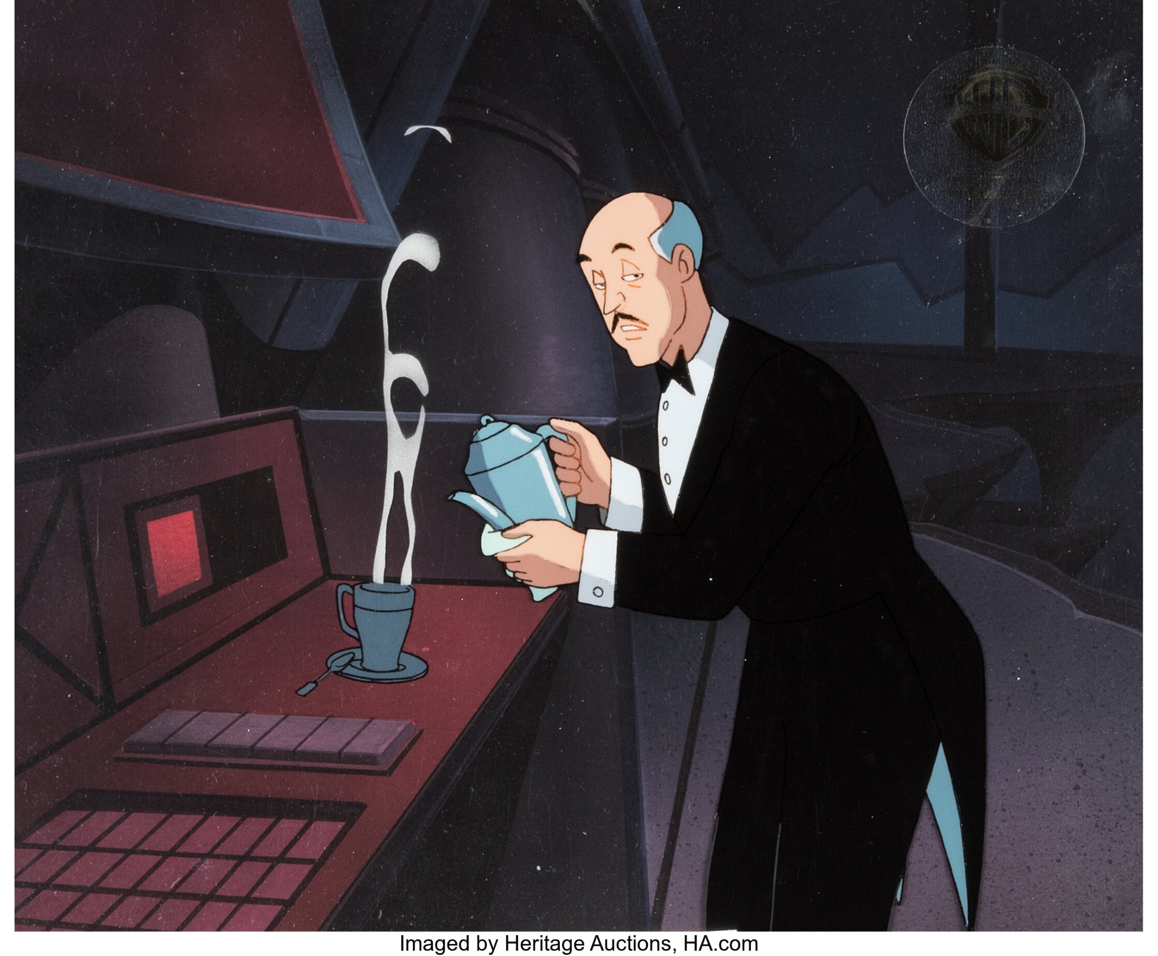
Spreadsheet Model Project Retirement Planning
Andy Converse, Erik Aune

Slide 2
Task and Assumptions
Task
We wanted to find how much would be best for Alfred to contribution.
We also wanted to find the best age for him to retire.
Assumptions
Alfred would contribution 2.5% of his paycheck, and his employer would contribute 5%.
Alfred would receive a 2% raise annually.
Inflation would increase 3% annually.
The account would grow by 4% annually.
Currently 37 years old
Wants to retire at 65 years old

Slide 3
How much will he have at retirement?
$5,000 $10,000 $15,000 $20,000 $25,000
37 $57,825 $62,825 $67,825 $72,825 $77,825
47 $258,023.55 $329,429.70 $400,835.85 $472,242.01 $543,648.16
57 $609,088.76 $789,698.14 $970,307.53 $1,150,916.91 $1,331,526.30
67 $1,213,034.51 $1,573,225.83 $1,933,417.15 $2,293,608.47 $2,653,799.78
77 $2,238,667.23 $2,894,176.47 $3,549,685.71 $4,205,194.96 $4,860,704.20
87 $3,964,861.85 $5,106,013.91 $6,247,165.96 $7,388,318.02 $8,529,470.078
97 $6,851,777.81 $8,791,557.12 $10,731,336.43 $12,671,115.74 $14,610,895.05
100 $8,046,960.65 $10,314,697.62 $12,582,434.58 $14,850,171.54 $17,117,908.5

Slide 4
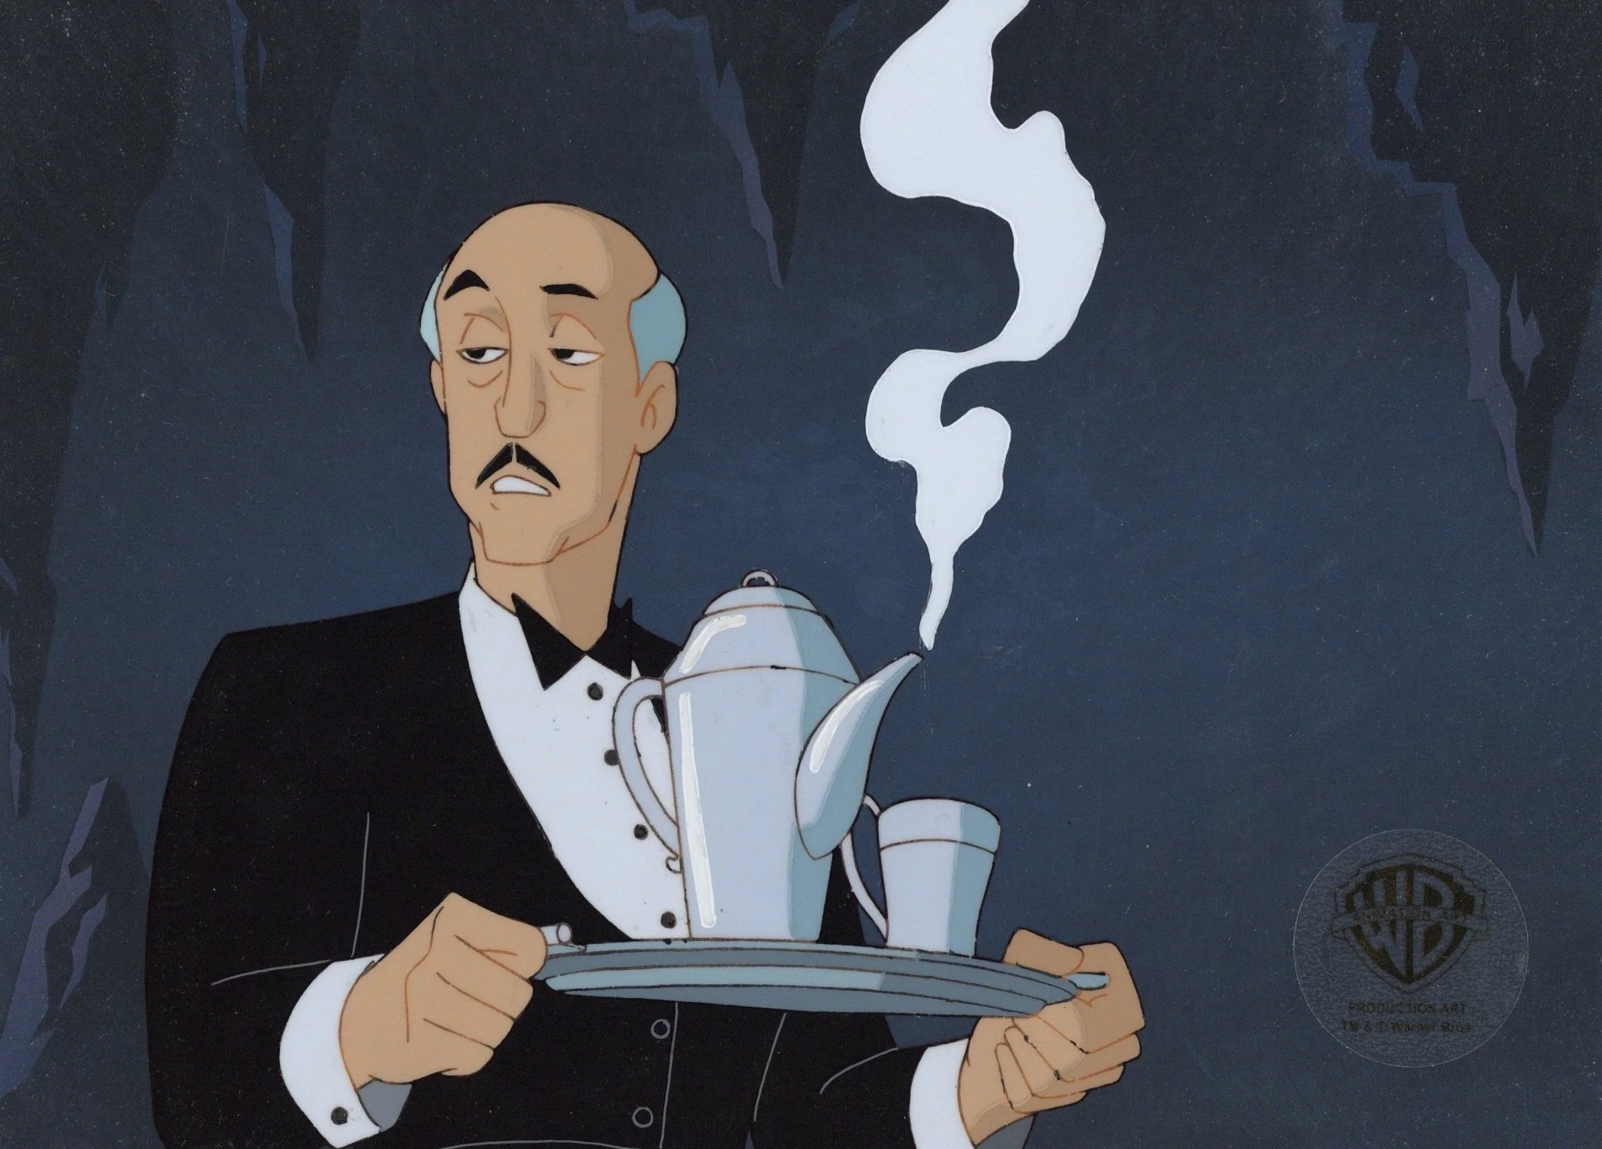
How do these outputs depend on different decisions that Alfred can make?
Additional Contributions play a big role in how much the Retirement Account grows.
By adding more when Alfred is young, the compounding interest on the account increases more over time.
The older Alfred stays out of retirement, The less additional contributions matter. This is because the account is large enough to grow on it’s own.
However, the longer Alfred works, the more the account will grow.

Slide 5
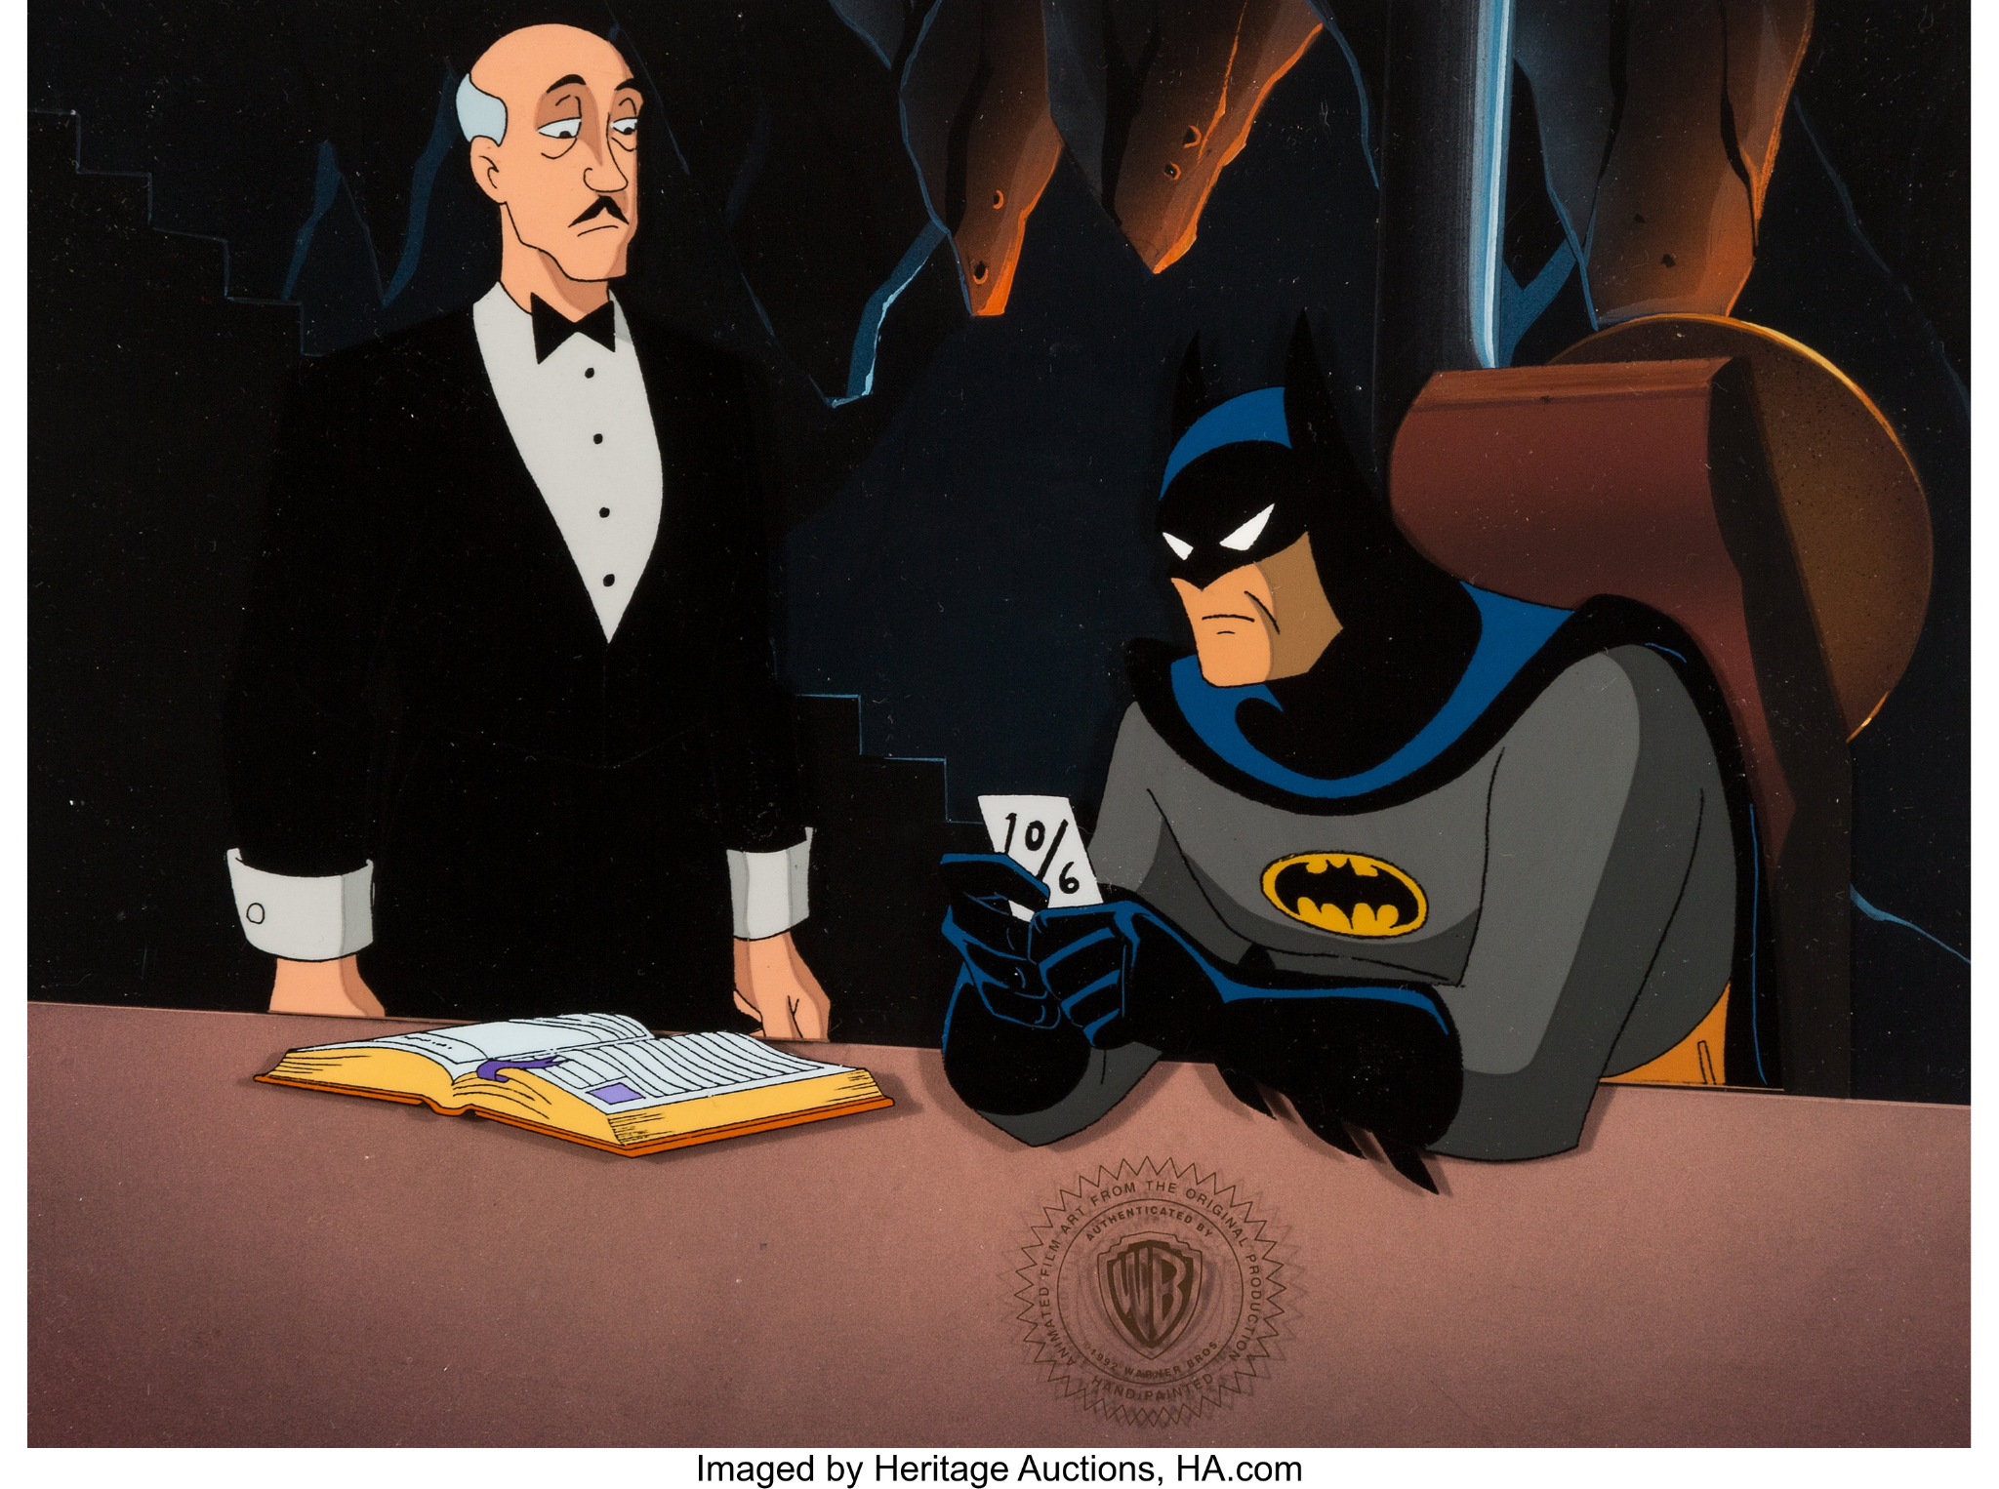
Recommendations
What age to retire?
65 Years Old
How much to contribute?
$16,000 per year
Age of depletion?
80 Years old

Slide 6
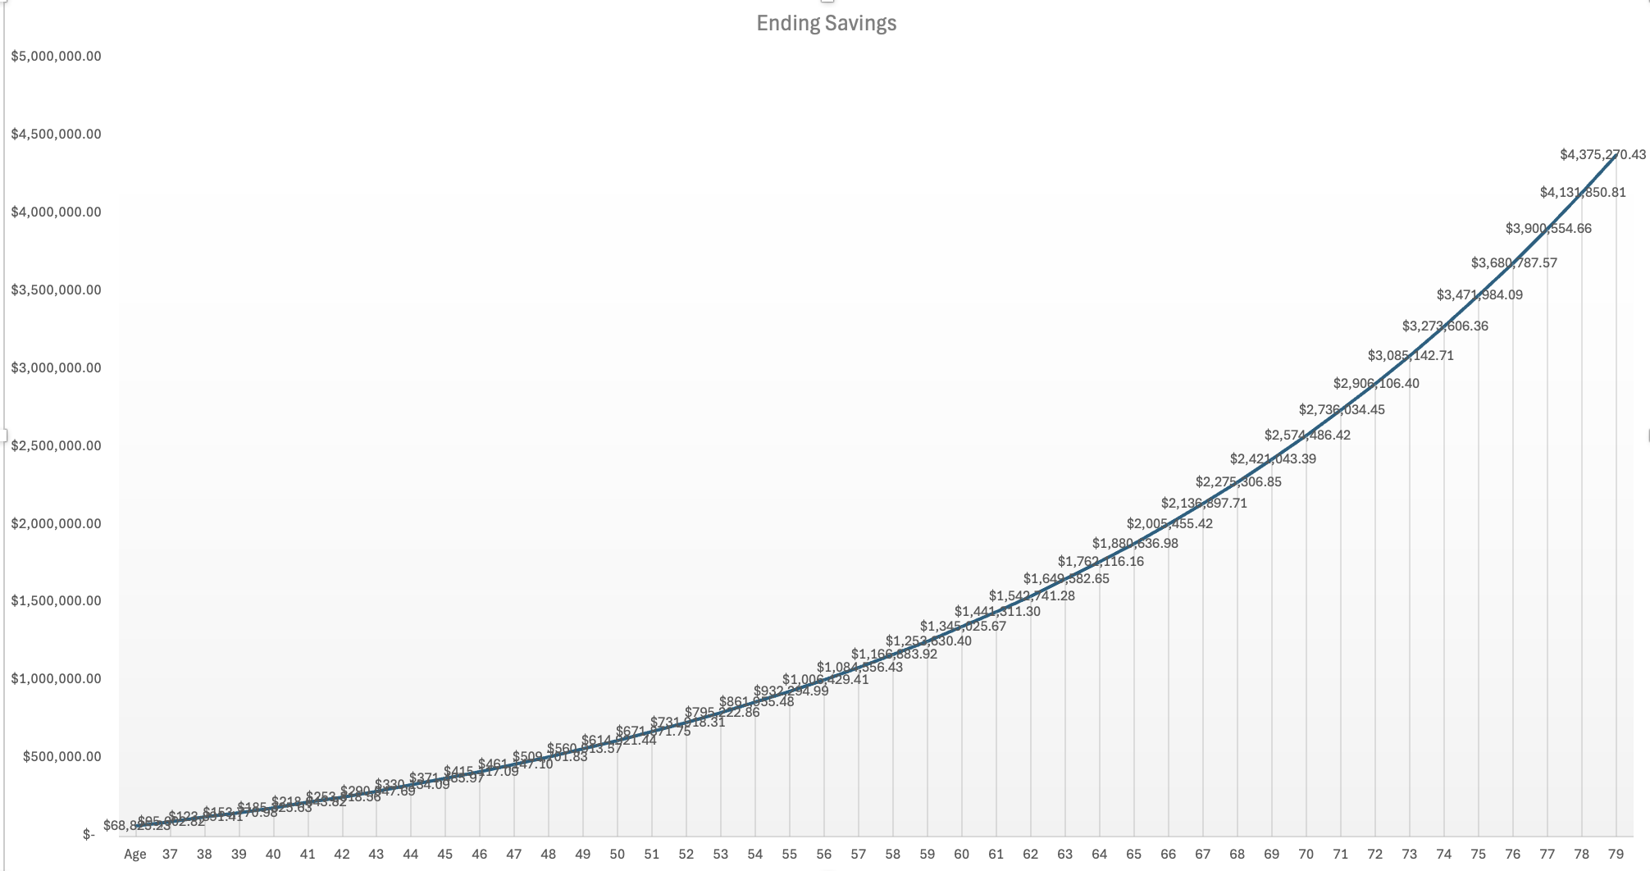
Outputs (assuming retirement at 65 and additional contributions at $16,000)

Slide 7
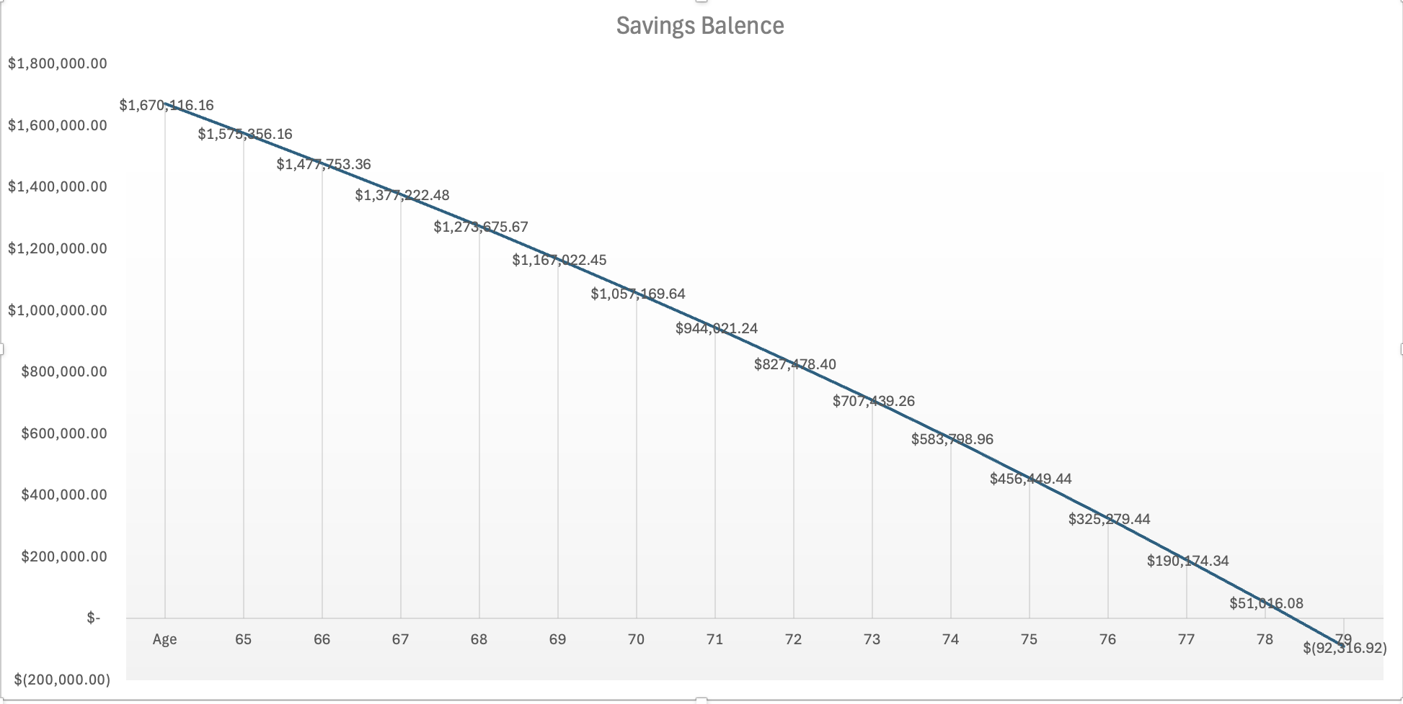
Outputs (assuming retirement at 65 and additional contributions at $16,000)

Slide 8
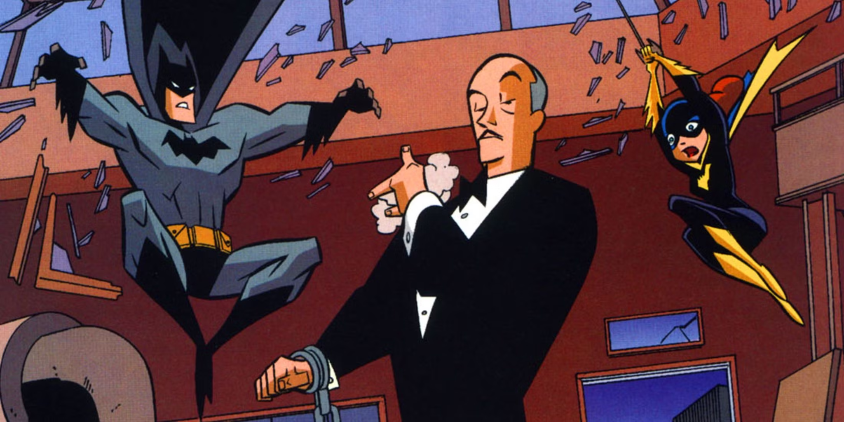
What other considerations may be important to Alfred’s retirement decisions?
Alfred could consider spending less in his retirement. This will affect how much longer he will have money.
Alfred could look to find passive income sources when he is young, such as dividends or real estate.

